Slide 1
Planet Formation
Topic:
Dust motion and
coagulation
Lecture by: C.P. Dullemond

Slide 2
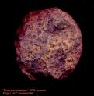
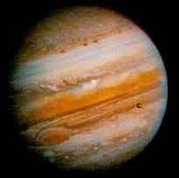
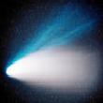
Coagulation as the start of planet formation
First growth phase
Final phase
Gravity
keeps/pulls
bodies
together
Gas is
accreted
Aggregation
(=coagulation)
1μm
1mm
1m
1km
1000km
Coagulation dominates
the growth of small
particles
Unclear if coagulation (=aggregation) is
dominant up to >km size planetesimals

Slide 3
Coagulation: What it is...
...if we look at a single pair of colliding particles:
x
hit and stick
t
Collision & sticking of „monomers“ leads to a „diamer“
which is a small „aggregate“

Slide 4
Coagulation: What it is...
...if we look at a single pair of colliding particles:
x
hit and stick
t
Collision & sticking of aggregates leads
to larger aggregates.

Slide 5
Coagulation: What it is...
...if we look at a single pair of colliding particles:
x
hit and stick
t
Such aggregate-aggregate collisions
leads to „fluffy“ aggregates

Slide 6
Coagulation is driven by
particle motion
Part 1: Stochastic motions:
Brownian Motion and Turbulence

Slide 7
Relative velocities between particles
Coagulation requires relative velocities between particles, so that they can hit and stick:
stochastic motions due to Brownian motion and turbulent stirring
systematic relative velocities due to particle drift
Brownian motion:
The smallest particles move the fastest, and dominate
the collision rate.

Slide 8
Turbulent stirring
Turbulence can induce stochastic motions of particles.
To compute this, we must first understand friction between dust and gas...
...and for this we must understand a few things about the Maxwell-Boltzmann distribution of the gas.
So hold on a moment as we discuss friction...

Slide 9
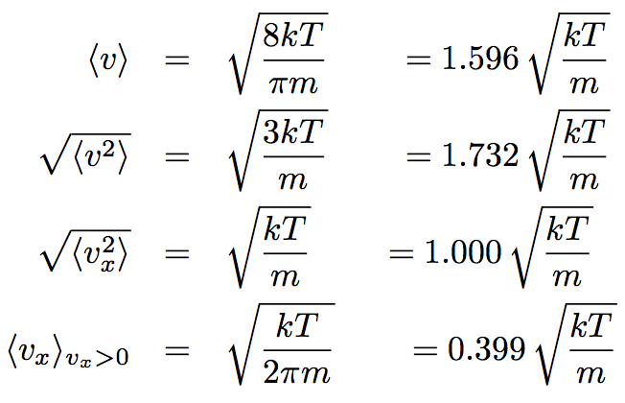
Maxwell-Boltzmann distribution
When we speak about „average gas particle velocity“ it can have
many different meanings, depending on how you do the averaging:

Slide 10
Friction between a particle and the gas
Take a spherical dust particle with radius a and material density ρ_{s}
Epstein drag regime = a<<λ_{mfp} and |v|<<c_{s}
dust particle
gas particles

Slide 11
Friction between a particle and the gas
Take a spherical dust particle with radius a and material density ρ_{s}
Epstein drag regime = a<<λ_{mfp} and |v|<<c_{s}
Collision rate of gas particles hitting dust particle from left(+)/right(-):
= gas density
Each particle comes in with average relative momentum (compared to the dust particle):
But leaves with thermalized momentum: i.e. a single kick.

Slide 12
Friction between a particle and the gas
Epstein drag regime = a<<λ_{mfp} and |v|<<c_{s}
Total drag is:
where

Slide 13
Friction between a particle and the gas
Epstein drag regime = a<<λ_{mfp} and |v|<<c_{s}
A more rigorous derivation, taking into account the full velocity
distribution and the spherical shape of the particle yields a slight
modification of this formula, but it is only a factor 4/3 different:
Note: Δv is the relative velocity between the particle and the gas:

Slide 14
Friction between a particle and the gas
The Epstein regime is valid for small enough dust particles.
Other regimes include:
Stokes regime: Particle is larger than gas mean free path
Supersonic regime: Particle moves faster than sound speed
For simplicity we will assume Epstein from now on, at least for this chapter.

Slide 15
The „stopping time“
The equation of motion of a dust particle in the gas is:
with
Solution:
The dust particle
wants to approach
the gas velocity
on a timescale
With:

Slide 16
back to: Turbulent stirring
Small dust grains have small stopping time, so they quickly adapt
to the local flow:
small
dust
grain
eddy
Big dust grains have long stopping time, so they barely adapt
to the local flow:
large
dust
grain
eddy

Slide 17
Turbulent stirring: The „Stokes Number“
Compare to largest eddy:
The ratio is called the „Stokes number“ (note: nothing to do with
„Stokes regime“)
The Stokes number tells whether the particle is coupled to the
turbulence (St<<1) or does not feel the turbulence (St>>1) or
somewhere in between.
It is a proxy of the grain size (large a = large St, small a = small St).

Slide 18
Turbulent stirring: Particle mean velocity
Due to turbulence, a particle acquires stochastic motions.
For St<<1 (small) particles these motions follow the gas motion.
For St>>1 (big) particles these motions are weak
log(Δv_{dust})
Δv_{eddy,large}
Large particles decouple
from the turbulence, so Δv_{d} goes down with increasing St.
Note: Small particles also
couple to smaller eddies,
but they are slower than
the largest one (see chapter
on turbulence)
St=1
log(St)

Slide 19
Turbulent stirring: Particle diffusion
Diffusion can transport particles, and is therefore important for
the dust coagulation problem.
For the gas the diffusion coefficient is equal to the gas viscosity
coefficient:
Because of the above described decoupling of the dust dynamics
from the gas dynamics, the dust diffusion coefficient is:
Youdin & Lithwick 2007
To remind you how D is „used“, here is the standard diffusion equation:

Slide 20
Turbulent stirring: Collision velocities
The stochastic velocities induced by turbulence can lead to
collisions between particles. This is the essential driving force of
coagulation. Let‘s first look at collisions between equal-size
particles:
log(Δv_{coll})
Δv_{eddy,large}
Large particles decouple
from the turbulence, so Δv_{coll} goes down with increasing St.
Small particles
of same size will
move both with the
same eddy, so their
relative velocity is small
St=1
log(St)

Slide 21
Turbulent stirring: Collision velocities
Now for collisions of a particle with St₁ with tiny dust particles
with St₂<<1. Now the decoupling of the large particle for St₁>>1
actually increases the relative velocities with the tiny dust particles!
log(Δv_{coll})
Δv_{eddy,large}
Large particles decouple
from the turbulence, they simpy feel gusts of wind from arbitrary directions, bringing along small dust.
Small particles
of same size will
move both with the
same eddy, so their
relative velocity is small
St₁=1
log(St₁)

Slide 22
Turbulent stirring: Collision velocities
Now for collisions of a particle with St₁ with big boulders with St₂>>1.
Now the coupling of the particle for St₁<<1 to the turbulence
increases the relative velocities with the boulders for the same
reason as described above.
log(Δv_{coll})
Δv_{eddy,large}
Small particles
will populate the „gusts of wind“ the big boulders experience, and thus will lead to large collision velocities
Large particles decouple
from the turbulence, so Δv_{coll} goes down with increasing St.
St=1
log(St)

Slide 23
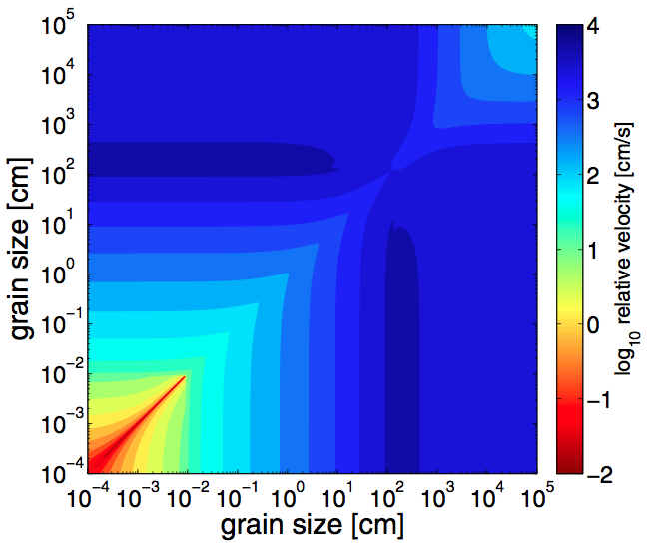
Turbulent stirring: Collision velocities
This diagram
shows these
results as a
function of
the grain sizes
of both parti-
cles involved
in the collision.
Windmark et al. 2012

Slide 24
Coagulation is driven by
particle motion
Part 2: Systematic motions:
Vertical settling and radial drift

Slide 25
Dust settling
A dust particle in the disk feels the gravitational force toward
the midplane. As it starts falling, the gas drag will increase.
A small enough particle will reach an equilibrium „settling
velocity“.

Slide 26
Vertical motion of particle
Vertical equation of motion of a particle (Epstein regime):
Damped harmonic oscillator:
No equator crossing (i.e. no real part of ω) for:
(where ρ_{s}=material density of grains)

Slide 27
Vertical motion of particle
Conclusion:
Small grains sediment slowly to midplane. Sedimentation velocity in Epstein regime:
Big grains experience damped oscillation about the midplane with angular frequency:
(particle has its own inclined orbit!)
and damping time:

Slide 28
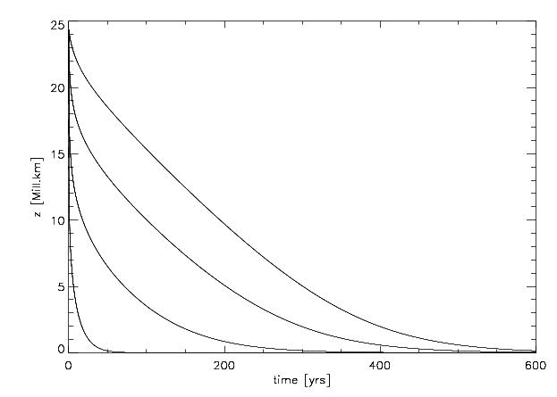
Vertical motion of small particle

Slide 29
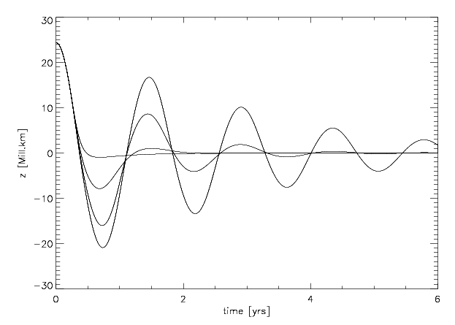
Vertical motion of big particle

Slide 30
Turbulence stirs dust back up
Equilibrium settling velocity & settling time scale:
Turbulence vertical mixing:

Slide 31
Settling-mixing equilibrium
The settling proceeds down to a height z_{sett} such that the diffusion
will start to act against the settling. Thus height z_{sett} is where the
settling time scale and the diffusion time scale are equal:
With
We can now (iteratively) solve for z to find z_{sett} .

Slide 32
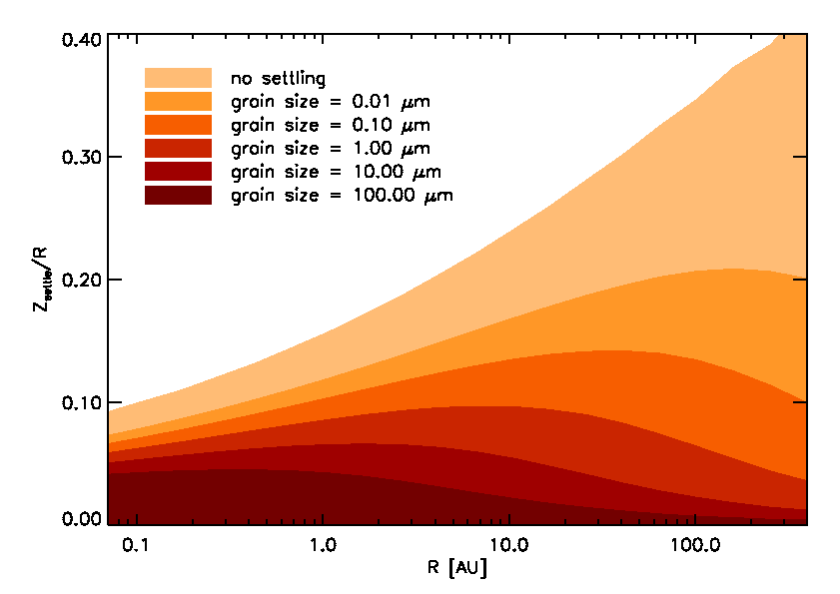
Settling-mixing equilibrium

Slide 33
Radial drift of large bodies
Assume swinging has damped. Particle at midplane with
Keplerian orbital velocity.
Gas has (small but significant) radial pressure gradient.
Radial momentum equation:
Estimate of dP/dr :
Solution for tangential gas velocity:
≈25 m/s at 1 AU

Slide 34
Radial drift of large bodies
Body moves Kepler, gas moves slower.
Body feels continuous headwind. Friction extracts angular momentum from body:
= friction time
One can write dl/dt as:
One obtains the radial drift velocity:

Slide 35
Radial drift of large bodies
Gas slower than dust particle: particle feels a head wind.
This removes angular momentum from the particle.
Inward drift

Slide 36
Radial drift of small dust particles
Also dust experiences a radial inward drift, though the
mechanism is slightly different.
Small dust moves with the gas. Has sub-Kepler velocity.
Gas feels a radial pressure gradient. Force per gram gas:
Dust does not feel this force. Since rotation is such that gas is in equilibrium, dust feels an effective force:
Radial inward motion is therefore:

Slide 37
Radial drift of small dust particles
Gas is (a bit) radially supported by pressure gradient. Dust not! Dust moves toward largest pressure.
Inward drift.

Slide 38
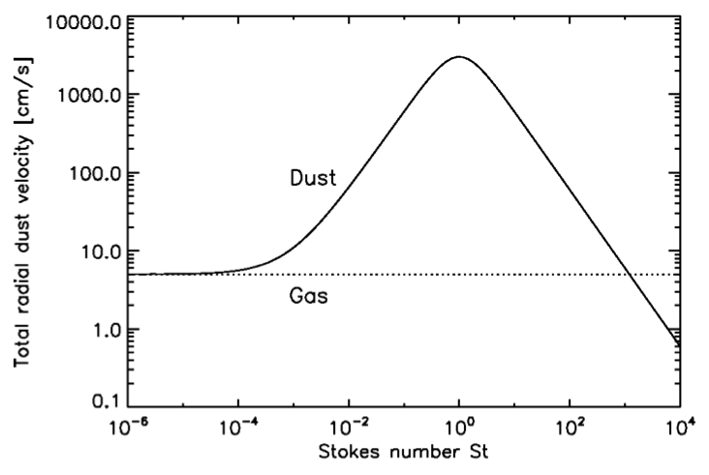
In general (big and small)
Brauer et al. 2008

Slide 39
Simple analytical models of
coagulation

Slide 40
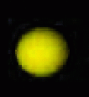
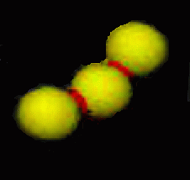
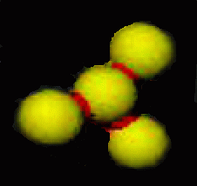
Two main growth modes:
Cluster-cluster aggregation
(CCA):
Particle-cluster aggregation
(PCA):
0.1 μm
0.1 μm

Slide 41
Simple model of cluster-cluster growth
Let us assume that at all times all aggregates have the same size
a(t), but that this size increases with time. We assume that we
have a total density of solids of ρ_{dust}. The number density of
particles then becomes:
The increase of m(t) with time depends on the rate of collisions:
Here we assume that the particles are always spheres. The
cross section of collision is then π(2a)².

Slide 42
Simple model of cluster-cluster growth
Let‘s assume Brownian motion as driving velocity:
The growth equation thus becomes proportional to:
The powerlaw solution goes as:
Mass grows almost linearly with time. Turns out to be too slow...

Slide 43
Simple model of cluster-particle growth
We assume that a big particle resides in a sea of small-grained
dust. Let‘s assume that the big particle has a systematic drift
velocity Δv with respect to the gas, while the small particles move
along with the gas. The small particles together have a density
ρ_{dust}. The big particle simply sweeps up the small dust. Then we
have:
The proportionalities again:
The powerlaw solution is:

Slide 44
How to properly model
the coagulation of 10³⁰ particles?

Slide 45
Particle distribution function:
We „count“ how many particles there are between grain size
a and a+da:
log(a)
Total mass in particles (total „dust mass“):

Slide 46
Particle distribution function:
ALTERNATIVE: We „count“ how many particles there are between
grain mass m and m+dm:
log(m)
Total mass in particles (total „dust mass“):

Slide 47
Particle distribution function:
Relation between these two ways of writing:
Exercise:
The famous „Mathis, Rumpl, Nordsieck“ (MRN) distribution goes
as
(for a given range in a)
Show that this is equivalent to:
And argue that the fact that
means that the MRN distribution is mass-dominated by the large
grains (i.e. most of the mass resides in large grains, even though
most of the grains are small).

Slide 48
How to model growth
Modeling the population of dust (10³⁰ particles!)
Distribution in:
- Position x = (r,z)
- Size a
- Time t
a
Aggregation Equation:

Slide 49
How to model growth
Modeling the population of dust (10³⁰ particles!)
1
2
3
4
5
6
7
8
9
10
11
12
mass

Slide 50
Simple model of growth
Relative velocities: BM + Settling + Turbulent stirring
Collision model: Perfect sticking
Dullemond & Dominik 2004

Slide 51
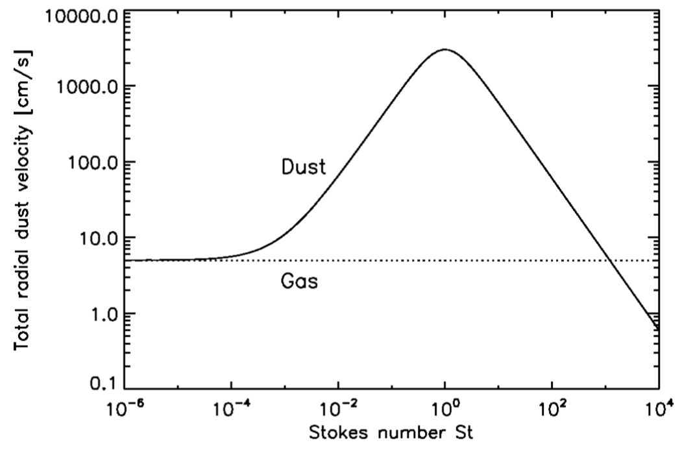
Main problem: high velocities
30 m/s =
100 km/h !!
Particle size [meter]

Slide 52
Dust coagulation+fragmentation model
10⁻²
10⁻⁴
Σ_{dust} [g/cm²]
10⁻⁶
10⁻⁸
10⁻⁴
10⁻²
10⁰
Grain size [cm]
Birnstiel, Dullemond & Ormel 2010

Slide 53
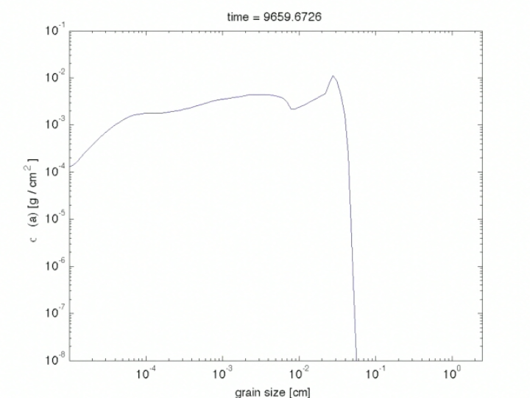
Dust coagulation+fragmentation model
10⁻²
10⁻⁴
Σ_{dust} [g/cm²]
10⁻⁶
10⁻⁸
10⁻⁴
10⁻²
10⁰
Grain size [cm]
Birnstiel, Dullemond & Ormel 2010

Slide 54
Meter-size barrier
Growth from ‘dust’ to planetary building blocks
Meter-size barrier
Rapid radial drift
Aggregation
Fragmentation
Sweep-up growth
Brownian
motion
Differential
settling
Turbulence
1μm
1mm
1m
1km

Slide 55
More barriers...
Growth from ‘dust’ to planetary building blocks
Charge barrier
Bouncing barrier
Meter-size barrier
Rapid radial drift
Aggregation
Fragmentation
Sweep-up growth
Brownian
motion
Differential
settling
Turbulence
1μm
1mm
1m
1km
Zsom et al. 2010, Güttler et al. 2010
Okuzumi 2009

Slide 56
The “Lucky One” idea
Let’s focus on the fragmentation barrier
Growth from ‘dust’ to planetary building blocks
Meter-size barrier
Rapid radial drift
Aggregation
Fragmentation
Sweep-up growth
Brownian
motion
Differential
settling
Turbulence
1μm
1mm
1m
1km

Slide 57
The “Lucky One” idea
Low sticking efficiency
Particle abundance
Windmark et al. 2012
How to create these seeds? Perhaps velocity distributions:
Garaud et al. 2013; Windmark et al. 2012

